Slide 1

BA05 - Implement private blockchain system
Dejan Micic

Slide 2
Kinds of blockchain:
- Private
- Public
- Consortium
Kinds of consensus protocols:
- PoA
PoW
PoS

Slide 3
Use-case and related work
Library
Adding books with author name, book name, publishing date and ISBN.
User can see who added a book to the blockchain.
Books have unique ISBN numbers.
User can search the blockchain for a single author to see what books are published.
Related work:
Alexandria – decentralized library for uploading and managing users work on the platform
Publica.com – Peer to peer publishing network for authors
Po.et – users timestamp their creation so that the user claims to be the owner of the work

Slide 4
Conceptual design
P2P network
Asynchronus communication
Socket
JSON object
Transaction and validation of the transaction
SHA-256 encrypting
Merkle tree
PoA
Singleton pattern

Slide 5
Implementation
Visual studio code
Java
Maven
Springboot
SHA-256 encrypting
Json
Socket

Slide 6
Implementation - Packages
Objects
ItemTransaction
Block
Merkle Tree
HashGenerator
Node
MerkleTree
Databases
TransactionNetworkDB
TransactionPool
TransactionsDB
Blockchain
CLI
CLIHandler
BlockchainApplication
transactionP2P
TransactionServer
TransactionSender

Slide 7
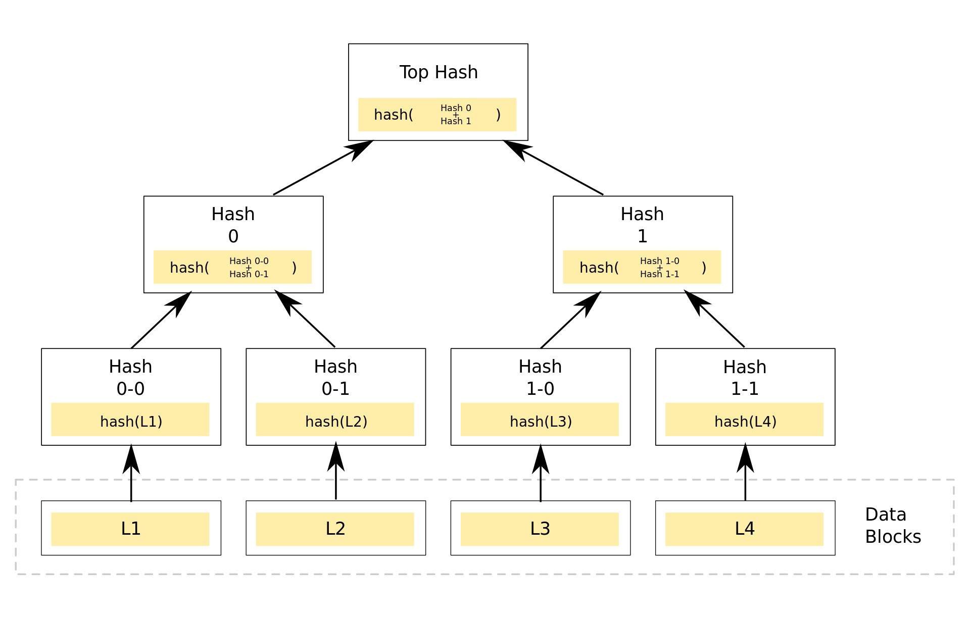
https://en.wikipedia.org/w/index.php?title=Merkle_tree&oldid=1159724280

Slide 8
JSON Object message types
Reg
Lis
Transaction
Listsize
luckyPort
blockchain

Slide 9
Future work
Change local databases that are linked lists into sql database.
Include functionality for the books to be borrowed.
Change CLI to a real webpage

Slide 10


Thank You
Dejan Micic

